Slide 1

Avkash Chauhan (avkash@h2o.ai)

Slide 2
Agenda
H2O Intro
Installation
Using H2O from FLOW, R & Python
Data munging in H2O with Python
Examples of machine learning problems
GBM, GLM, DRF
Understanding Models, improvements,
Machine learning production pipeline
H2O.ai is a Visionary in the Gartner Magic Quadrant
for Data Science Platforms

Slide 3
Architecture
Q

Slide 4
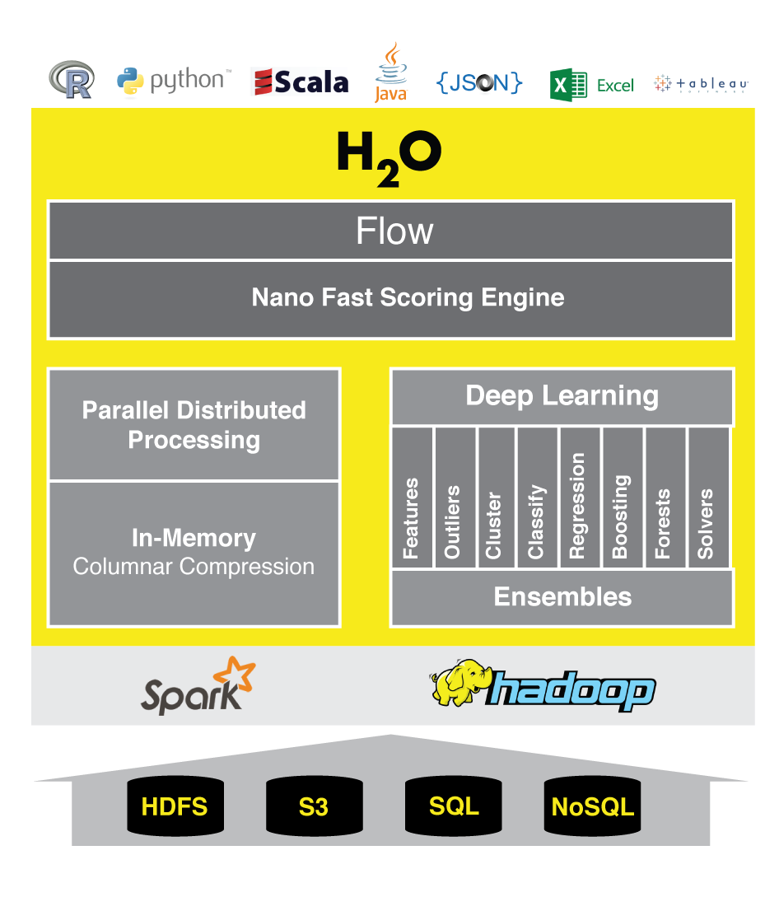
H2O Architecture
H2O Core Engine
“In memory”
No persistence!
Bring up, work, take down.
Where can I run it?
Locally, Hadoop, Spark
Java based – almost anywhere!
Client APIs
Access the core engine through
Web (Flow UI)
Python, R

Slide 5

















Core H2O: Detailed Architecture
Production
Environments
REST / JSON
HDFS
Parse
Exploratory
Analysis
ML
Algorithms
Scoring
POJO
S3
Feature
Engineering
Model
Evaluation
Data/Model
Export
Local
Fluid Vector Frame
Job
NFS
Distributed K/V Store
MRTask
Non-Blocking Hash Table
Distributed Fork/Join
SQL
Distributed In-Memory Processing

Slide 6
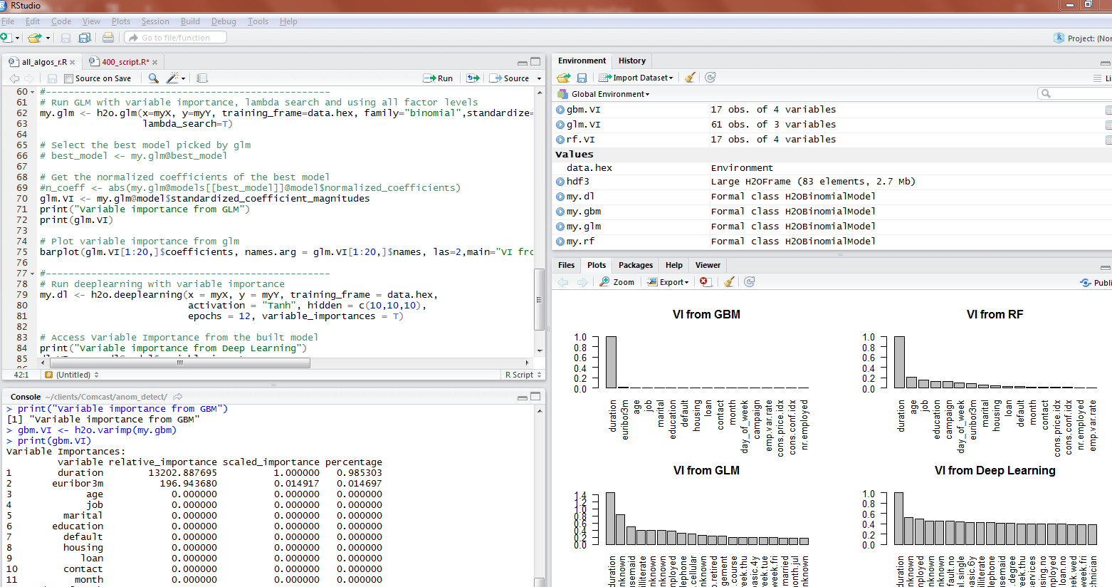
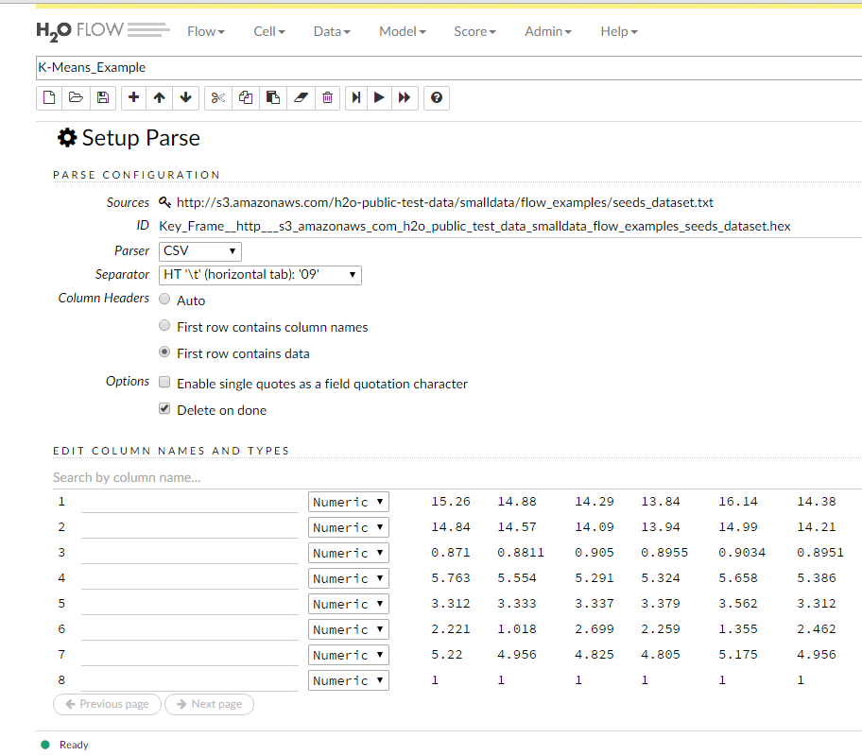
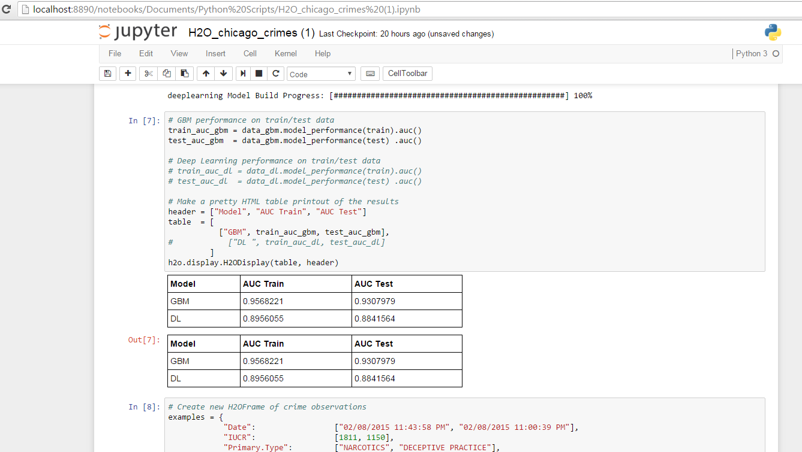
R, Python and Flow

Slide 7
Memory Management
Frames/Vectors/Chunks
A Frame is an H2O Data Frame, the basic unit of data storage exposed to users.
The Frame->Vector->Chunk->Element taxonomy that stores data in memory is described in Javadoc.
The Fluid Vector (or fvec) code is the column-compressed store implementation
Distributed K/V store
Atomic and distributed in-memory storage spread across the cluster.
No High Availability!
Non-blocking Hash Map
Used in the K/V store implementation.

Slide 8
CPU Management
Job
Jobs are large pieces of work that have progress bars and can be monitored in the Web UI. Model creation is an example of a job.
MRTask
MRTask stands for MapReduce Task. This is an H2O in-memory MapReduce Task, not to be confused with a Hadoop MapReduce task.
Fork/Join
A modified JSR166y lightweight task execution framework.

Slide 9
How to launch H2O locally
Use standalone version
java –jar h2o.jar
Python Client
pip install h2o # installs from PyPi
import h2o
R Client
install.packages(“h2o”) # installs from CRAN
library(h2o)
When in doubt use http://h2o.ai/download

Slide 10
Products and Features
Q

Slide 11

H2O Platform(s)
DEEP WATER
In-Memory, Distributed Machine Learning Algorithms with H₂O Flow GUI
H2O AI Open Source Engine Integration with Spark

Slide 12
Key features
Open Source (Apache 2.0)
All supported ML algorithms are coded by our engineers
Designed for speed, scalability and for super large data-sets
Same distribution for open source community & enterprise
Very active production, every other week release
Vibrant open source community
https://community.h2o.ai
Enterprise Support portal
https://support.h2o.ai
We have 70,000 users, 8,000 organizations and growing daily

Slide 13
Usage: Simple Solution
Single Deployable compiled Java code (jar)
Ready to use point and click FLOW Interface
Connection from R and Python after specific packages are installed
Use Java, Scala natively and any other language through RESTful API
Deployable models - Binary & Java (POJO & MOJO)
One click prediction/scoring engine

Slide 14
Usage: Complex Solution
Multi-node Deployment
Spark and Hadoop distributed environment
Sparkling Water (Spark + H2O)
Data ingested from various inputs
S3, HDFS, NFS, JDBC, Object store etc.
Streaming support in Spark (through Sparking Water)
Distributed machine learning for every algorithm in platform
Prediction service deployment on several machines

Slide 15
Current Algorithm Overview
Statistical Analysis
Linear Models (GLM)
Naïve Bayes
Ensembles
Random Forest
Distributed Trees
Gradient Boosting Machine
R Package - Stacking / Super Learner
Deep Neural Networks
Multi-layer Feed-Forward Neural Network
Auto-encoder
Anomaly Detection
Clustering
K-Means
Dimension Reduction
Principal Component Analysis
Generalized Low Rank Models
Solvers & Optimization
Generalized ADMM Solver
L-BFGS (Quasi Newton Method)
Ordinary Least-Square Solver
Stochastic Gradient Descent
Data Munging
Scalable Data Frames
Sort, Slice, Log Transform
Data.table (1B rows groupBy record)

Slide 16
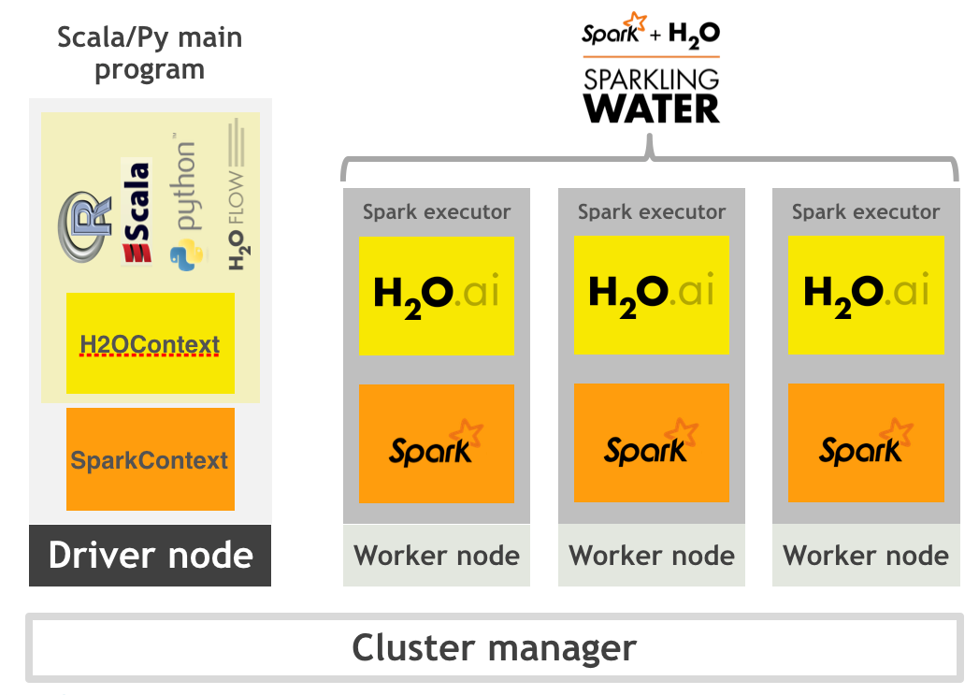
Sparkling Water - High Level Architecture

Slide 17

Deep Water : Architecture
R/Py/Flow/Scala client
REST API
Web server
H₂O Java
Execution Engine
RPC
H₂O Java
Execution Engine
Scala Spark
Scala Spark
grpc/MPI/RDMA
TensorFlow/mxnet/Caffe
C++
TensorFlow/mxnet/Caffe
C++
GPU
CPU
GPU
CPU
Node 1
Node N

Slide 18
H2O Installation
Q

Slide 19
What we covered with H2O Installation
Installation, using H2O with R & Python
Installation H2O
Help – help(h2o.init), h2o.cluster_status()
H2O Github repo
Source code - glance
R package installation
Python Package Installation
Connecting H2O from R
Connecting H2O from Python
Q

Slide 20
Data manipulation between H2O, R & python
Q

Slide 21
Data manipulation between H2O, R, python
Import data in between H2O, python, R and others..
H2O
R, python, Java, Scala, etc..
360⁰ View
Q

Slide 22
Importing Data in H2O
upload_file()
import_file()
Uses local file system to pull data then push the H2O cluster
Does a single threaded push of the data from local machine
Works with variety of sources (web, local, HDFS etc)
Does a parallel/distributed multi-threaded pull of the data.
Note: It is good to use import_file() when not sure

Slide 23
Data manipulation between H2O, R, python
Part 1
Import data in python
import pandas as pd
datasetpath = "/Users/avkashchauhan/tools/datasets/kaggle-imdb-word2vec”
train_data = pd.read_csv(datasetpath + "/labeledTrainData.tsv", header=0, delimiter="\t", quoting=3)
h2o.ls()
train_data.describe()
train_data_h2o = h2o.H2OFrame(train_data, destination_frame = "train_data_h2o")
h2o.ls()
train_data_h2o.describe()
Now Look the same frame in the FLOW - getFrames
In R
> h2o.ls()
> rdf = h2o.getFrame("train_data_h2o")
> rdf
> summary(rdf)
Q
Reference: http://localhost:8888/notebooks/H2O-start-test-and-data-switch-python-r.ipynb

Slide 24
Data manipulation between H2O, R, python
Part 2
Import data in R
> iris
> mydf = as.h2o(iris)
This frame will be imported as iris original frame name
> summary(mydf)
> summary(iris)
> h2o.ls()
You will see the iris entry as h2o frames list
Check FLOW as well and you will see iris there too
> mydf = as.h2o(iris, destination_frame = “mydf”)
> h2o.ls()
In Python
h2o.ls()
my_python_df= h2o.get_frame("mydf")
my_python_df
h2o.ls()
Q

Slide 25
What we covered Data munging in H2O with python
H2O and Python
Jupyter notebook Demo
Data import
Row, column, data frames, slicing, binding, exporting, factoring
Using functions
Reference:
[1] http://localhost:8888/notebooks/H2O%20Data%20Ingest%20Demo.ipynb
Q

Slide 26
What we covered
Data Import
Understood data, frame distribution, chunk, compression etc.
Understood all features, through histograms, enums, etc.
Split data frames for train and test
Converting features to Factors/Enum
Imputation of values
Training
with Training frame only
With cross-validation
with validation frame
Understanding Model details
Documentation
http://docs.h2o.ai/h2o/latest-stable/h2o-docs/index.html

Slide 27
Thank you so much
Notes:
Koeidesu

